Slide 1
Assess the Stakeholder Landscape
Notes:
Welcome to the second module in CSTE’s online learning course, entitled “Creating an Action Plan for Opioid Surveillance.”
This module is entitled, “Assess the Stakeholder Landscape” and corresponds to the first step in the four-step process to create an action plan for opioid surveillance.

Slide 2
Speaker Introduction
Carol McPhillips-Tangum, MPH
Notes:
My name is Carol McPhillips-Tangum and I will be your online course instructor for this module.

Slide 3

Session Goals
Provide an overview of stakeholder analysis and mapping
Use stakeholder analysis and mapping as tools to:
  Identify stakeholders
  Understand stakeholders
  Recognize the roles that stakeholders play in your opioid surveillance activities
Notes:
The goals of this session are to provide an overview of stakeholder analysis and mapping, which we will explore as tools that you can use to identify stakeholders – including some that you may consider to be “non-traditional” stakeholders in your opioid-related work.
We will show you how to use stakeholder analysis and mapping as tools for better understanding your stakeholders with respect to their interests and needs, as well as recognizing the roles that your stakeholders play (or could play) in your opioid surveillance activities.

Slide 4

Learning Objectives
Define stakeholder analysis and mapping
Explain the value of including non-traditional stakeholders in your opioid surveillance plan
Identify at least three stakeholders with an important role in your jurisdiction
Notes:
Upon completing this online module, you will be able to:
Define stakeholder analysis and mapping;
Explain the value of including non-traditional stakeholders in your opioid surveillance plan and activities; and
Apply the principles of stakeholder mapping to identify at least three stakeholders who play an important role in opioid surveillance within your jurisdiction

Slide 5

What are Stakeholders?
Individuals, groups, or organizations with an interest in your project
Internal and external
Primary and secondary
A rule of thumb for identifying stakeholders
Notes:
What do we mean by the term “stakeholders” and how can we be sure that we’ve identified the key stakeholders?
Stakeholders can be individuals, groups, or organizations with an interest (or potential interest) in your project or opioid surveillance plan.
These stakeholder might be internal or external. Internal stakeholders could include other individuals, groups, departments, or divisions that exist within your health department and who have an interest in opioid surveillance – regardless of whether they have recognized or acted on that interest. External stakeholders, on the other hand, could include individuals, groups, or organizations that exist outside of your health department and who have at least some interest in opioid surveillance (again, whether they know it or have acted on it yet).
Stakeholders are also sometimes thought of as being primary or secondary. Primary stakeholders are those who are most directly involved and that have the greatest likelihood of already being involved in your opioid surveillance plan (i.e., the department of vital statistics/records, the coroner or medical examiner). Secondary stakeholders are those who might be considered intermediaries in the opioid surveillance process and these are probably not the first people, groups, or organizations that you initially think of when you think about opioid surveillance (i.e., hospital association, needle exchange program).
A general rule of thumb for ensuring that key stakeholders have been included in the process is to question whose support or lack of it might significantly influence the success of your opioid surveillance activities.
Another rule of thumb is to think about an article or news spot about opioids in your community…Anyone who might stop to read, listen to, or watch news coverage of the opioid crisis should probably be considered a stakeholder.
In this course, we will introduce you to a tool that can be used to map stakeholders according to criteria such as interest and influence.

Slide 6

What is Stakeholder Analysis?
An approach for:
Identifying key stakeholders
Assessing their interests and needs
Predicting how these interests and needs could affect your project
Notes:
So what is stakeholder analysis?
Stakeholder analysis is a critical tool for identifying key stakeholders. In this , we will introduce some tools that can be used to identify the individuals and organizations that have an actual – or potential – stake in your opioid surveillance plan. Use of these tools should help prevent “blind spots” that can have a negative affect on your project or surveillance plan.
Through stakeholder analysis, the interests and needs of each stakeholder is considered and clarified…
And you will have the opportunity to think critically about how stakeholder interests and needs will affect your project or surveillance plan.

Slide 7
Stakeholder Analysis Benefits
Get your project into shape
Leverage resources
Build understanding
Get ahead of the game
Identify blind spots
Notes:
There are many benefits to conducting stakeholder analysis.
We previously mentioned that one of the benefits of stakeholder analysis is to identify blind spots by identifying stakeholders whose support you might really need for your project.
You can also use stakeholder analysis to get your project, in this case your opioid surveillance plan, into the best shape possible. For example, you can use the opinions of your most powerful stakeholders to help define your opioid surveillance activities at an early stage. These stakeholders will then be more likely to support you, and their input can also improve the quality of your surveillance efforts.
Gaining support from powerful stakeholders can help you to leverage resources, such as people, time or money. This makes it more likely that your opioid surveillance activities will be successful and sustainable.
By communicating with your stakeholders early and often, you can ensure that they fully grasp what you’re doing and understand the benefits of your opioid surveillance activities. This means that they can more actively support you when necessary.
Understanding your stakeholders means that you can anticipate and predict their reactions to your opioid surveillance activities. This allows you to get ahead of the game, so to speak, by planning opioid surveillance activities and strategies that will be agreeable to your key stakeholders.

Slide 8
Opioid Stakeholders
Public health
Government
First responders
Criminal justice
Health care
Education
Media
And more…
Notes:
There are many different individuals, groups, and organizations that could be considered key stakeholders in the development of an opioid surveillance plan. When you are working on an issue as complex as the opioid crisis, it would be a mistake to rely solely on the “usual suspects” oronly on your closest and traditional public health partners.
Instead, you should think about stakeholders much more broadly. Opioid surveillance stakeholders could include:
Public health, such as state and local health departments, and the officials who work in these agencies
Government, such as the coroner or medical examiner, the Governor, state or local legislators, state or local health commissioner, etc.
First responders, such as police, fire, private ambulance services, 911 dispatchers, etc.
Criminal justice, including jails and prisons, drug courts, and probation offices.
Health care, including medical professionals, hospitals, health care associations, dentists and even veterinarians.
Education agencies and educators, schools, school districts, colleges/universities and Boards of Education.
Media, including public radio, public TV and newspapers.
And, so many more….

Slide 9
Four Steps
Notes:
So now that we understand the benefits of getting to better know and understand our stakeholders, let’s talk about stakeholder analysis and mapping.
There are four steps to stakeholder analysis and mapping.
Each of these steps is fairly straightforward but, like many other activities, what you get out of stakeholder analysis depends on what you put into it.
We encourage you to thoughtfully proceed through each of these steps to ensure that you identify and increase your understanding of all the stakeholders related to your opioid surveillance activities.

Slide 10

Step 1:Identify Stakeholders
Begin by brainstorming
  Those interested in the opioid crisis and those affected by the opioid crisis
  Internal and external
  Data suppliers and users
Think of your list as a “working document”
  Stakeholders can and will change over time
Notes:
Step 1 is to identify your key stakeholders.
This process should begin with a brainstorming session in which you and/or your team create a list of all the various individuals, groups, and organizations that have (or could have) an interest in your opioid surveillance plan. This can include internal and external stakeholders, those who provide (or could provide) data needed for your opioid surveillance activities and those who receive (or could benefit from receiving) such data. The goal is to be as inclusive as possible to identify a wide range of stakeholders and eliminate any of the “blind spots” that we previously mentioned.
Remember that your key stakeholders can and will change over time, so consider your list of key stakeholders to be a “working document” – meaning that it is not set in stone, and it will need to be revisited and updated as circumstances related to opioids and surveillance change.

Slide 11

Step 2: Assess Stakeholders
Answer key questions about each stakeholder…
What are the opioid issues of most interest?
Is the stakeholder a data supplier, user, or both?
How is this stakeholder connected to other stakeholders?
Do we have a point of contact in the group or organization?
What are the next steps to initiate or sustain engagement?
Notes:
Once you’ve created a list of your current key stakeholders, you’re ready to assess your stakeholders.
The purpose of stakeholder assessment is to get to know your stakeholders. As such, you will need to answer questions designed to clarify what each stakeholder has to gain or lose as a result of being involved in your opioid surveillance plan.
Ask yourself, what are the opioid issues of most interest to each stakeholder?
Is the stakeholder a data supplier, data user, or both?
Is this stakeholder connected to your other stakeholders – if so, how?
If the stakeholder is a group or an organization, do you have a point of contact? – perhaps someone known to you from a another current or previous project?
Because we are working toward the development of an action plan for opioid surveillance, it is important that we identify the next steps or actions that we will take with each stakeholder. So, as part of the stakeholder assessment process you should also ask yourself -- What are the next steps for initiating or sustaining engagement with each stakeholder?

Slide 12

Step 3: Map Stakeholders
Thinking about each of your key stakeholders…
How influential is this stakeholder to the success of your opioid surveillance activities?
How interested is this stakeholder in your opioid surveillance activities?
Map each stakeholder according to influence and interest
Use mapping information to inform stakeholder engagement
Notes:
After you’ve created an initial list of your key stakeholders and completed the stakeholder assessment activity, take a moment to think about each stakeholder’s current level of influence and interest.
Ask yourselves how much each stakeholder can currently influence the success of your opioid surveillance activities. Another way to think about this is: how likely is it that each stakeholder could really help you with your opioid surveillance activities – or could interfere with (or even sabotage) your opioid surveillance activities if not supportive.
Then ask yourselves how interested each stakeholder currently is in your opioid surveillance activities. Perhaps the stakeholder is highly interested and has been involved or wanting to be involved, or the stakeholder is not yet interested at all.
After you’ve thought about these questions, you’ll be able to map or position each stakeholder according to his or her current level of influence and interest in your opioid surveillance activities.

Slide 13
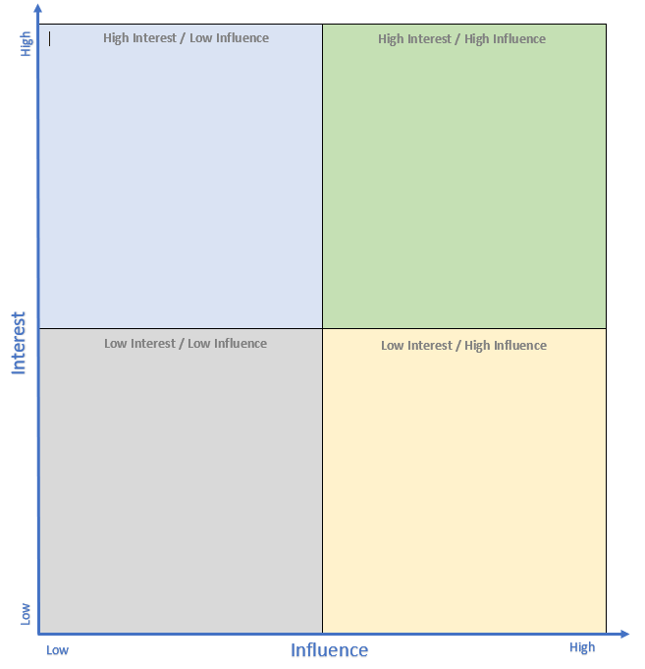
Step 4. Use Map to Inform Stakeholder Engagement
In this example…
Manage Janet effectively as a powerful supporter/champion
Keep Claire happy while actively trying to build interest
Keep Ron informed and look for opportunities to increase influence
Keep James informed with minimal effort and resources
Ron
Janet
Keep informed
Manage closely
Claire
Monitor (minimal effort)
Keep satisfied
James
Notes:
You can use a stakeholder map, such as the one shown here, to make decisions about how often and in what ways you will engage your stakeholders.
Let’s walk through an example of how to use a stakeholder map to inform stakeholder engagement.
For this example, we will map four fictional stakeholders.
Let’s assume you have a stakeholder named Janet and you through your stakeholder analysis process you identified as a stakeholder who is highly influential and highly interested. Your charge is to manage this relationship closely. You must fully engage people like Janet and make the greatest efforts to keep them happy and engaged.
Now let’s look at Claire. Claire is just as influential as Janet, but currently less interested. Your charge is to keep Claire satisfied while looking for opportunities to peak her interest in your opioid surveillance activities. For example, maybe you could share data with Claire that would be useful to her in her own work and help her to see the value of your surveillance activities.
Next, let’s look at Ron. Ron is highly interested in your opioid surveillance work, but not particularly influential. You should keep Ron informed to maintain his interest, while also looking for opportunities to increase his influence. For example, you might be able to offer Ron a spot on a workgroup or committee that could increase his visibility and credibility.
Lastly, let’s look at James. James is neither interested in your opioid surveillance work or very influential. You shouldn’t spend too much time or resources engaging James, but don’t let him drop completely off your radar. Continue to provide low-level and low resource-intensive outreach to James and occasionally offer him an opportunity to become more involved. You never know when James might change positions or change his attitude and therefore be in a better position to become more interested and/or influential in your opioid surveillance activities.

Slide 14
Resources
Notes:
There are several resources related to stakeholder analysis and mapping that you can download from the Resources section of the CSTE online learning module.

Slide 15
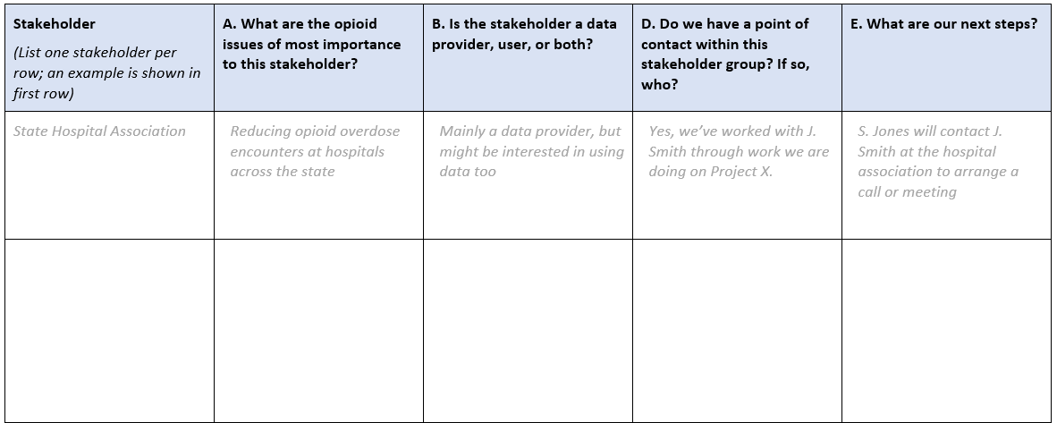
Stakeholder Analysis Worksheet
Notes:
One of the resources available on the Resources section of the CSTE online learning module is the stakeholder analysis worksheet.
Here you can see an image of the first page of the worksheet and an example of how to complete the worksheet.
We encourage you to download this resource and fill it out according to the instructions that you will find at the top of the worksheet.

Slide 16
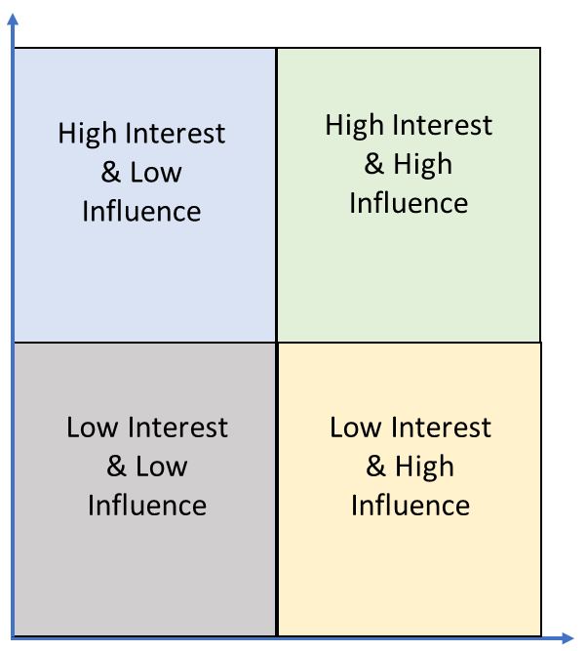
Stakeholder Mapping Matrix
Interest
Influence
Notes:
Another of the resources available on the Resources section of the CSTE online learning module is the stakeholder mapping matrix.
Here you can see an image of the stakeholder mapping matrix. We reviewed an example of how to complete this mapping matrix when we discussed how this map can be used to inform stakeholder engagement.
We encourage you to download this resource and fill it out according to the instructions that you will find at the top of the worksheet.

Slide 17
Congratulations!
You’ve completed this module. When you’re ready, please proceed with the data landscape module.
Thank you!
Notes:
You’ve now completed the second module of this online course.
When you’re ready, please proceed with the next module, which is about the various data sources and indicators that you could use as part of your opioid surveillance activities.

Slide 18
CSTE National Office
2635 Century Parkway NE, Suite 700
Atlanta, Georgia 30345
770.458.3811
770.458.8516
dboyd@cste.org

