Slide 1
Assess the Data Landscape
Notes:
Welcome to the third module in CSTE’s online learning course for “Creating an Action Plan for Opioid Surveillance.”
This module is entitled, “Assess the Data Landscape” and corresponds to the first step in the four-step process to create an action plan for opioid surveillance.
What is the data landscape? The term data landscape refers to what data sources exist in the your jurisdiction, what information each source contains, what indicators each source could track, how the data is organized, and what limitations exist in each data or indicator that could impact opioid surveillance. What information does each indicator convey and how could it be misinterpreted by an audience?
They data landscape is closely linked to our earlier work to identify and understand our opioid stakeholders. Many stakeholders may be owners, providers, and consumers of opioid surveillance data. Stakeholder insights can provide meaningful context to data landscapes. Stakeholder agendas can inform which data sources are a priority. Relationships with stakeholders can facilitate data access.

Slide 2
Speaker Introduction
Emily Kraus, MPH, PhD
Notes:
My name is Emily Kraus and I’m your facilitator for this module. I’ve been working in Public Health for 15 years and I’m excited to speak with you today about such an important topic. I received my public health training with an MPH from Emory University’s Rollins School of Public Health and a PHD in informatics from University of Colorado Denver (PhD). I worked at Denver Public Health department for ten years in epidemiology and informatics experience and completed the Public Health Prevention service fellowship with CDC.

Slide 3

Session Goal
To identify data sources and indicators that can provide meaningful opioid information in a format and at a frequency that is actionable for you and your stakeholders
Notes:
The goal of this module is to identify data sources and indicators that can provide meaningful opioid information in a format and at a frequency that is actionable for you and your stakeholders.
The data landscape will be different in every jurisdiction. There will be some data sources and indicators that are universal. But each jurisdiction will inevitable have data sources and indicators of interest specific to their community and stakeholders. This section will focus on data sources and indicators that are most likely available near you but we will touch on some other data sources that selected states may be using for opioid surveillance.

Slide 4

Learning Objectives
Identify and compare common opioid data sources and indicators including their strengths and limitations
Explain the opioid surveillance challenges of ICD codes
Describe next steps for accessing data from new or prioritized data sources
Notes:
At the end of this module, you will be able to:
Identify and compare common opioid data sources and indicators,
Discuss the challenges for opioid surveillance related to ICD codes, and
Describe next steps for accessing data from prioritized data sources.

Slide 5

Key Considerations
Many sources of data about opioids
No gold standard for opioid surveillance
Opioid surveillance should be:
  Driven by the needs and interests of local stakeholders
  Customized to local context (e.g. data sources and indicators)
Notes:
As we talk together about data sources and indicators, several key considerations are important to keep in mind. First, there is no shortage of opioid data. While the data public health has access to is insufficient for many health issues, that is not the case for opioid. Additionally, there is no gold standard for how opioid surveillance should occur. There is a national framework and many robust local examples and best practices exist for you to draw from. However, each data source that a public health entity takes on is a major commitment of resources, especially accessing a net new potentially complex data source. Organizing, managing, analyzing, and visualizing data takes tons of time and can be costly. So the most important aspects of opioid surveillance is that its realistic, feasible, and meets the needs of your stakeholders.

Slide 6
Opioid Surveillance Questions
How are opioids prescribed?
    What conditions?
    What dosage or duration of prescription?
Who uses opioids?
  What populations are likely using opioids?
Who misuses opioids?
    Who has OUD (Opioid Use Disorder)?
    How many need and are accessing treatment?
  How many nonfatal opioid overdoses and overdose deaths occur?
  Where are overdose deaths concentrated?
  Which opioids are causing overdoses?
Notes:
Defining our surveillance questions is a good place to begin an examination of the data landscape. What are the high level questions you are trying to answer wit data?
Because prescription opioids play a huge role in the opioid epidemic, we are tasked with understanding the circumstances of opioid prescribing. Information about who is prescribed opioids raises additional questions about what conditions and care settings are driving opioid prescribing, what dose they are receiving and for what duration.
We also want to know who uses and misuses opioids of any kind. Which populations are at the highest risk. Opioid misuse data leads to inquires about what proportion of opioid users have been diagnosed with OUD and their ability to access treatment.
And that leads us to inquire about overdoses. How many? How often? Who? Where?

Slide 7

What are the Data Sources?
Common Data Sources
Death certificates (a.k.a., vital statistics)*
Coroner or medical examiner data*
Emergency Department (ED) and hospitalization discharge datasets*
National Survey of Drug Use and Health (NSDUH)
Prescription Drug Monitoring Program (PDMP)
*Data sources are highlighted in CDC ESOOS program
Notes:
Aligning with these questions, there are five data sources that are available in almost every jurisdiction: death certificates, coroner or medical examiner data, discharge datasets for ED and hospitalization, national survey of drug use and health, and the PDMP.
One thing you may have noticed about the most common data sources are that they are, for the most part, supported by statute. Statutory requirements to collect death records, report discharges, and enter prescriptions are one of the primary mechanisms to ensure that this data is always collected and that we all have access to this information.

Slide 8
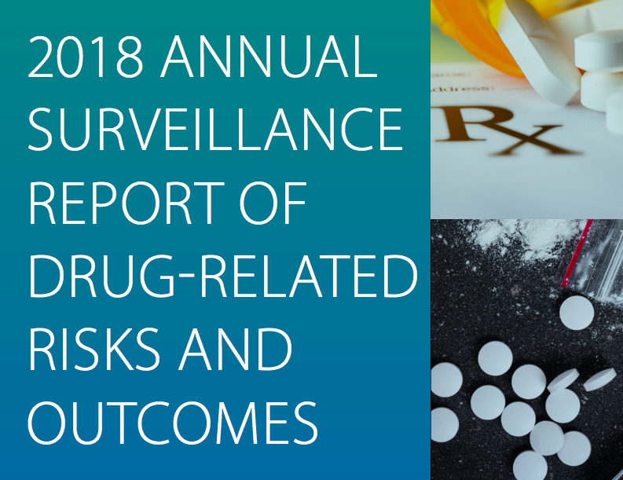
National Opioid Surveillance Landscape
Opioid prescribing trends (2006-2017)
Drug use, misuse, and substance use disorder and treatment from National Survey of Drug Use and Health
Nonfatal drug overdose emergency department visits and hospitalizations
Drug overdose mortality trends (1999-2016)
Source: CDC, 2018
Notes:
How do the data sources used to track the opioid epidemic at the state and local level align with the national opioid efforts. What data sources is CDC using and what indicators are national opioid leaders tracking to understand the epidemic? When we examine a 2018 national opioid surveillance report from CDC, we see alignment with the data sources and indicators used to measure this epidemic across the nation. While many emerging health topics don’t have strong national guidance, the CDC has produced a huge amount of opioid surveillance guidance and detailed methodological information that can serve as a foundation for public health departments.
Now we will discuss each of these data sources in detail.

Slide 9

Death Certificates
ICD-10 codes identify cause of death
  Indicator: Drug and opioid overdose counts and rates
  SAMHSA ICD-10 code list
Strengths: systematic data collection, trends over time, county and national comparisons, demographic sub-groups
Limitations: only fatal overdoses, small numbers, under-reporting, difficult to discern intentional vs unintentional, lack of drug specificity on death certificates
Notes:
Death certificates are likely quite familiar to you. !CD-10 codes are used to assign a cause or causes to each death and can be used to identify opioid related deaths. ICD-10 codes are quite specific and SAMHSA has created a guide that provides the list of ICD-10 codes that can be used to identify opioid related deaths. Subsets of these codes can be used to identify opioid deaths more specifically like a heroin overdose. Death certificates collect structured data and provide detail about the person’s demographic and geographic attributes. This data is collected systematically we because deaths are required by law to be reported, its safe to assume that not too many deaths are missing from this data source. This is a robust and reliable source of mortality data that can be used to study trends over time and make local and national comparisons.
There are a few limitations that you should keep in mind when using death certificates. Remember that not all overdoses are fatal and not all fatal overdoses are correctly coded as ‘overdose’ which would cause underreporting. Only fatal overdoses are included, which can paint an incomplete picture of overdose burden. Opioid deaths for some smaller jurisdictions may be a relatively rare event which can lead to small counts and unstable rate estimates. It can be challenging to differentiate between an accidental and intentional opioid overdose. And drug specificity in death investigation and coding can lack specificity.

Slide 10

Death Certificate Coding Challenges
ICD-10 codes associated with an overdose death can be tricky:
Overdose deaths can be hard to categorize
Overdoses often involve multiple opioids and other drugs
Some ICD-10 codes include multiple opioids or are general
  No specific Fentanyl overdose code
Some synthetic opioids do not yet have designated codes
  More new synthetic opioids in the future
Notes:
ICD 10 codes and coding are imperfect in a few notable ways. Overdose deaths can be hard to categorize as intentional or accidental. Overdoses often involve multiple opioids and other drugs, and it coding practices can vary between jurisdictions. Some ICD-10 codes include multiple opioids or are general. Many synthetic opioids, including Fentanyl, do not have a specific over dose code. This will continue to be a challenge as more new synthetic opioids enter the environment.

Slide 11

Coroner/Medical Examiner (C/ME) Data
Detailed investigation about circumstances of death
  C/ME appointment and laws vary by and within state
  Many C/ME are focused on opioid deaths
Strength: quality and detail of death information
Limitation: Narrative or unstructured data are difficult to analyze, not all deaths investigated, sensitive data
Notes:
Coroner medical examiner data can be an incredibly rich data source. Coroner and medical examiners are focused on determining the cause and manner of death using results of autopsies and laboratory tests including toxicology tests for the presence of alcohol or drugs. However, the landscape of Coroner and medical examiners varies by jurisdiction in many ways. Some states have one central electronic data system while other states have multiple systems or operate using paper forms and scans. This can have an impact on the quality of this data. Additionally, the requirements and training for coroners and medical examiners differs dramatically. Some communities may have a well-trained medical doctor as their medical examiner while others may have a coroner with little to no training. For example, some coroners and medical examiners collect very detailed information on a suicide decedent’s life circumstances, mental health history, treatment status, etc., while others do not. Some, but not all, coroners and medical examiners request that a psychological autopsy be conducted to determine if a death was a suicide.
Coroner data is a focus of the ESOS grant funding and combined with toxicology data and death certificate data to create entries for overdoses in the SUDORS system. The main strength of this data source is the level of detail. But because not all deaths are investigated, this data cannot be used for trend analysis. Additionally, this is sensitive data and can be difficult to access and difficult to work with. Some coroners or medical examiners rely on paper or unstructured notes to record a death investigation.

Slide 12

ED and Hospitalization Discharge Data
Diagnosis codes specific to overdose, opioid use disorder, & adverse events
  CDC overdose ICD-10-CM code list
Strengths: captures non-fatal overdoses and adverse events, includes special populations, comorbid conditions
Limitations: data quality, subjective coding, ICD-9-CM to ICD-10-CM October 2015 transition, difficulty accessing data, timeliness
Notes:
Another opioid surveillance data source is emergency department (ED) and hospitalization discharge data. Hospitals and EDs are required to submit information about the diagnoses, procedures, and encounter information for each patient. Public health can use this data to quantify the burden of ED visits and hospitalization using ICD-9 and ICD-10 diagnosis codes that identify opioid related conditions like opioid use disorder or events like an overdose. This can be valuable when trying to understand the burden of non-fatal overdoses.
Additionally, diagnosis codes can be used to examine comorbid conditions. Special populations like individuals experiencing homelessness and struggling with opioids are often present in this dataset and can, depending on the data be identified.
The challenges associated with discharge data vary by the structure and method for its collection. There is concern around the transition from ICD-9 to ICD-10 codes in October of 2015 which makes trends that cross this period of time questionable. Additionally, this data is only as good as the diagnosis codes that are entered. Some opioid adverse event diagnosis codes are broad and could represent opioid related constipation, an opioid allergy, or and opioid dependence.

Slide 13
Tips for ED and Hospitalization Data
Which codes will you use?
    Z79.891: Long term (current) use of opiate analgesic
Order of codes (primary vs. all codes)
Is a person level identifier available to create an individualized rate?
Did any new hospitals begin contributing data during the observation time period?
How are geocodes generated?
    What processes do hospitals report for flagging bad addresses?
    Are those included or removed?
Notes:
These key indicators can provide insights into each surveillance question. The MME, prescriptions, and prescribed days from the PDMP can be converted into a rate per capita to describe the opioid prescribed population and to track changes over time. Opioid use and misuse prevalence is available from NSDUH for adults over 12 years of age each year and can show trends and differences between age groups. Examining diagnosis codes in the discharge dataset can quantify the frequency of an oud or overdose related ED visit or hospitalization and death certificate data can measure opioid overdose deaths. The key indicators in your jurisdiction may be very different. You may be focused more closely on fentanyl overdoses, or heroin use, or prescriptions to young adults or duration of prescriptions following surgery.

Slide 14
National Survey of Drug Use and Health (NSDUH)
Annual SAMHSA survey that provides state level data on substance use, treatment, and youth behaviors and generates comprehensive reports
Strengths: trends over time, comparison to other states, detailed substance specific questions
Limitations: no county data, delayed, excludes institutional and homeless, all questions not included every year
Notes:
The National Survey of Drug Use and Health is an in depth national survey administered by SAMSHA conducted every year. This survey explores how substances and mental health conditions impact health among individuals 12 years of age and older. National and state estimates are released every year for data collected from the previous year. This survey includes a number of questions about opioid use, misuse, dependence and treatment. Because this survey is administered systematically, it is a strong source of trend data and is useful for state to state comparisons. However, this survey does not produce data below the state level and the results are released annually with a substantial delay. It is not the most timely data source.

Slide 15

Prescription Drug Monitoring Program (PDMP)
Statewide electronic database that tracks prescriptions of controlled substances
Prescribers and pharmacists can access patient records of dispensed controlled substance prescriptions
Strengths: aid in clinical decision-making, surveillance of overdose risk, potential to share data across states
Limitations: can be difficult to access, data access is restricted, data cleaning is intensive, does not include illicit drugs
Notes:
Almost every data has a PDMP which is an electronic database that tracks prescriptions of controlled substances. Prescribers and pharmacists submit data about prescriptions written and dispense and they can access patient records of dispensed controlled substance prescriptions. PDMPs assemble a patient’s entire medication profile into one record so that a prescriber can see a complete history of all the medications prescribed from all providers. PDMPs include data from retail pharmacies as well as Veterans Administration and Indian Health Service dispensers in most states; some military dispensers administered by the U.S. Department of Defense don’t provide data to PDMPs. PDMPs can aid providers in decision-making and facilitate surveillance of overdose risk. Additionally, some PDMPs can share data across states.
However, PDMP data can be challenging to access. PDMP data at the record level can require a lot of cleaning and does not include illicit drugs.

Slide 16
Prescription Drug Monitoring Program (PDMP) Con’t
Strengths: Tool to aid in clinical decision-making, surveillance of overdose risk, for complete longitudinal record, some PDMP’s share data across states
Limitations: states determine which medications must be reported, can be difficult to access

Slide 17
Additional Data Sources
EMS, NEMSIS, 911
Corrections data
Treatment or Support
  Treatment Episode Dataset
  Methadone
  Syringe Services Programs
Surveys (BRFSS, YRBS, NHBS)
Claims (All Payer Claims Database or Medicaid)
EHR data (diagnoses, medication prescribing and dispensing)
National Syndromic Surveillance Program (NSSP)
CDC WONDER
AHRQ’s Healthcare Cost and Utilization Project (HCUP)
Marketscan
IQVIA
Notes:
Beyond these common data sources, a number of additional data source may exist in your jurisdiction that can provide helpful opioid surveillance information are listed here. However, this list is not exhaustive. We are beginning to see interesting public health surveillance work done with EMS data including joining EMS to hospitalization or claims data. Public health is learning more about opioid treatment data including the TEDS dataset and methadone treatment information. Many public health agencies are exploring work with their all payer claims database or Medicaid claims. EHR data and syndromic surveillance systems are promising sources of information.

Slide 18
Indicators and Analytic Methods
Notes:
With that foundation of data sources, we’d like to talk now about indicators and analytic methods that may be useful in opioid surveillance.

Slide 19
Common Indicators
Opioid prescribing rate/days/MME/dose per capita
Opioid use and misuse prevalence
OUD prevalence (self-reported)
OUD treatment estimates
Non-fatal drug overdose ED visits
Non-fatal drug overdose hospitalizations
Drug overdose mortality rate
Opioid overdose rates (unintentional, undetermined, suicide)
EMS opioid overdose rate
Notes:
In the CDC’s 2018 surveillance report, the opioid epidemic is described using four data sources and four primary indicators:
1. Opioid prescribing rates from prescription drug monitoring program data,
2. Opioid use and misuse prevalence from the national survey of drug use and health
3. Nonfatal overdose emergency department visits and hospitalizations from hospital discharge datasets
4. And fatal overdoses rates from mortality data
These are the primary indicators being used to track changes in the opioid epidemic. Many states and locales are focused on one or all of these indicators. If a jurisdiction tracks these indicators, it would be easy to compare local trends to national trends and understand if your community was struggling more or less than the national average.
One thing that is important for you be diligent and aware of is a distinction between the terms drug and opioid. Those terms are technically different but information about health outcomes related to ‘drugs’ often appears in opioid surveillance. Survey data does show that a majority of drug misuse is opioid misuse and a vast majority of drug overdoses are caused by opioids but it is important to remember that these concepts are not the same.

Slide 20
Setting Indicator Goals
Stakeholder messages | Supporting indicators
How big is the epidemic? | Count of overdoses (fatal and non-fatal) Count and cost of opioid-related ED visits or hospitalizations
How do opioids compare to other causes of death? | Overdose mortality rate Leading causes of death
How serious is the epidemic? | Average age of overdose deaths Total years of life lost from overdose
Is the epidemic getting worse? | Trends in overdose death rates Trends in opioid misuse prevalence Trends in local clusters
Who do opioids impact? | Overdose and opioid misuse demographic profile
Notes:
Its helpful to select or prioritize indicators by thinking through what messages you want to share with your stakeholders. This table shows some examples of how different indicators are tools to support different messages. What are the indicators you would use to demonstrate how big the epidemic is?

Slide 21
Less Common Indicators
Multiple provider episodes
High dose opioid prescriptions
Overlapping Benzodiazepine/Opioid prescriptions
Population rate of Naloxone kit distribution
Population rate of Suboxone prescribers
*ESOOS Focus
Notes:
In the CDC’s 2018 surveillance report, the opioid epidemic is described using four data sources and four primary indicators:
1. Opioid prescribing rates from prescription drug monitoring program data,
2. Opioid use and misuse prevalence from the national survey of drug use and health
3. Nonfatal overdose emergency department visits and hospitalizations from hospital discharge datasets
4. And fatal overdoses rates from mortality data
These are the primary indicators being used to track changes in the opioid epidemic. Many states and locales are focused on one or all of these indicators. If a jurisdiction tracks these indicators, it would be easy to compare local trends to national trends and understand if your community was struggling more or less than the national average.
One thing that is important for you be diligent and aware of is a distinction between the terms drug and opioid. Those terms are technically different but information about health outcomes related to ‘drugs’ often appears in opioid surveillance. Survey data does show that a majority of drug misuse is opioid misuse and a vast majority of drug overdoses are caused by opioids but it is important to remember that these concepts are not the same.

Slide 22
Indicator Complexity
Prescribing | Use and Misuse | OUD and Treatment | Overdose | EMS
Prescriptions can be sold, given away, or abused Heroin is not prescribed Not all providers use a PDMP Out of state patients | Many take opioids as indicated Quantifying misuse is challenging, especially from prescribing data | Treatment medications can be abused Fragmented treatment landscape Naloxone false positives | Some overdoses aren’t detected Some overdoses go untreated | Multiple coding standards in NEMSIS Require numerous overdose case definitions
Notes:
We all know that no analytic method or indicator is without limitations. When it comes to opioids, there are a number of issues that can add complexity to analysis and interpretation of each indicator. Opioid prescriptions can be sold, stolen, and other things. How opioids were prescribed for use does not always equal how they were used. Heroin is missing from prescription information. Additionally, not all providers use the PDMP and some individuals use providers and pharmacies in multiple states so PDMP data is not always a complete. picture.
Opioid use and misuse is very complex because many individuals on chronic opioid therapy take opioids as prescribed and they are often physically dependent. Where do we put these folks? Additionally, because of dosage and polypharmacy, assembling an accurate estimate of use and misuse is challenging. OUD is also complex for the same reasons. Many individuals have not yet been diagnosed with OUD and OUD is a relatively new concept for many providers who may feel unsure about issuing that diagnosis.
Treatment landscape is fragmented and treatment for OUD is a combination of many different attributes. Naloxone can be tricky. Some individuals who receive naloxone who are not experiencing an overdose.
Regarding overdoses, some overdoses are untreated and undetected.

Slide 23
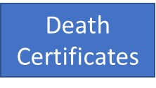
Combining Insights across Data Sources and Indicators
What is the burden of opioid overdoses?
Fatal overdoses
Non-fatal overdoses
911
ME Data
EMS and Police
ED and Hospitalizations
Syndromic Surveillance
Notes:
One analytic method which isn’t a method as much as it is an approach is to address limitations by braiding data from multiple sources together to create the most clear picture of a single concept. Consider overdoses, fatal and non-fatal. Thinking back to the slide about overdose data opportunities, how can we combine data across these five sources to measure overdoses most effectively.
Syndromic is not ideal for tracking fatalities, but could be useful in linking with other sources.

Slide 24
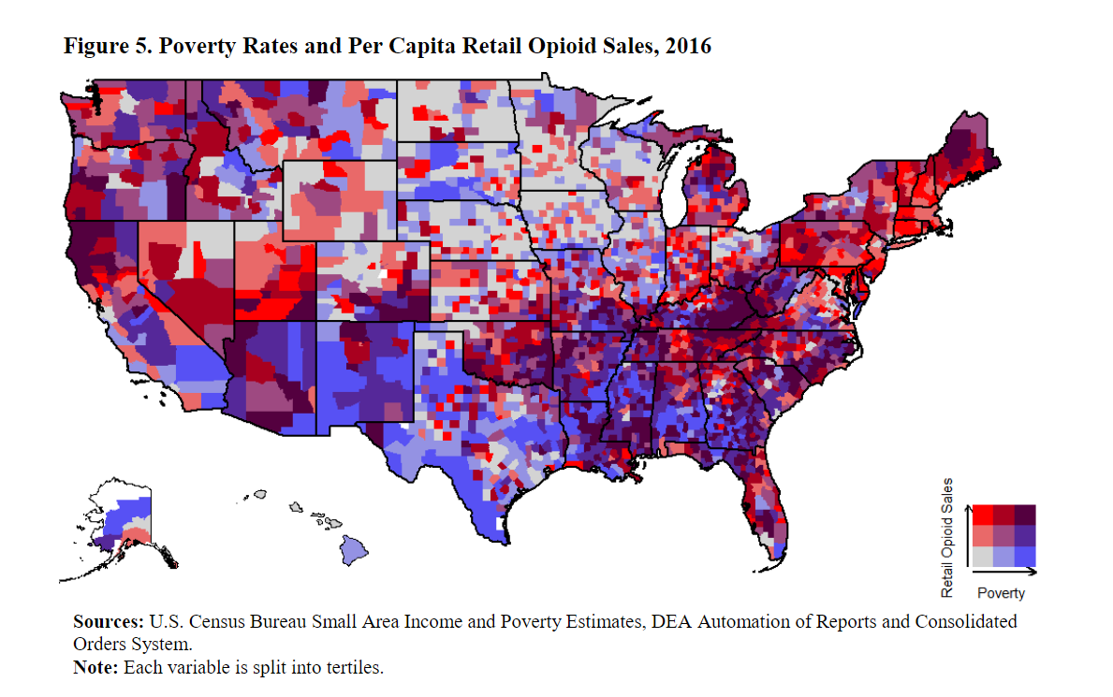
Ex: Combining Data Sources
Source: NSDUH
Notes:
https://www.ncbi.nlm.nih.gov/pmc/articles/PMC2946404/. This map combines poverty rates and per capita opioid retail sales from several different data sources and shows this comparison at a county level to visualize the relationship between geographic trends and these two linked factors.

Slide 25
Resources
Notes:
There are several resources in your workbook that are related to stakeholder analysis.
I’ll explain each of these resources and then you will have a chance to use them in just a few minutes to conduct your own stakeholder analysis.

Slide 26
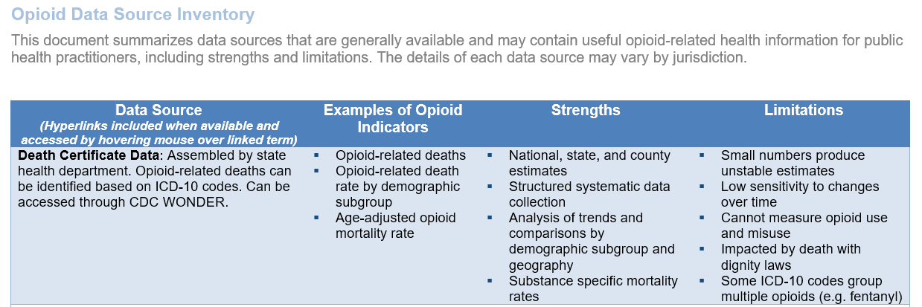
Data Source Inventory
Notes:
One of the resources available on the Resources section of the CSTE online learning module is the Data Source Inventory, which will provide you with a great deal of information about data sources that can be used as part of your opioid surveillance efforts.
Here you can see an image of the first page of the Data Source Inventory.

Slide 27
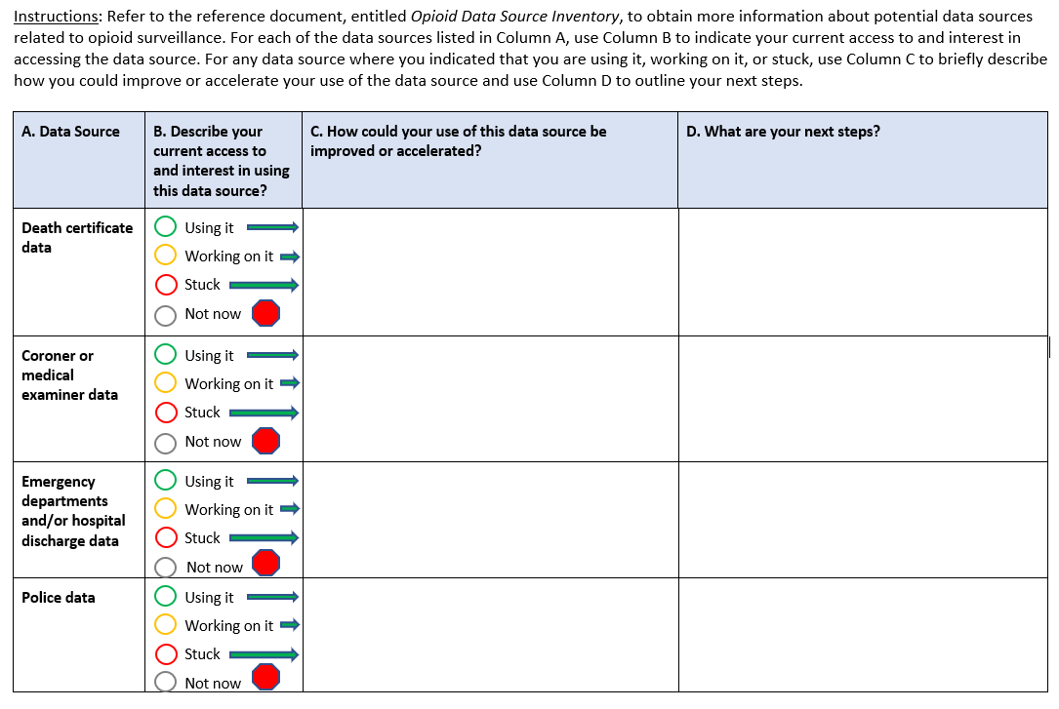
Data Inventory Worksheet
Notes:
Another of the resources available on the Resources section of the CSTE online learning module is the data inventory worksheet.
Here you can see an image of the first page of the worksheet and an example of how to complete the worksheet.
We encourage you to download this resource and fill it out according to the instructions that you will find at the top of the worksheet.

Slide 28
Congratulations!
You’ve completed this module. When you’re ready, please proceed with the data access and analysis module.
Thank you!

Slide 29
CSTE National Office
2635 Century Parkway NE, Suite 700
Atlanta, Georgia 30345
770.458.3811
770.458.8516
dboyd@cste.org

